Slide 1
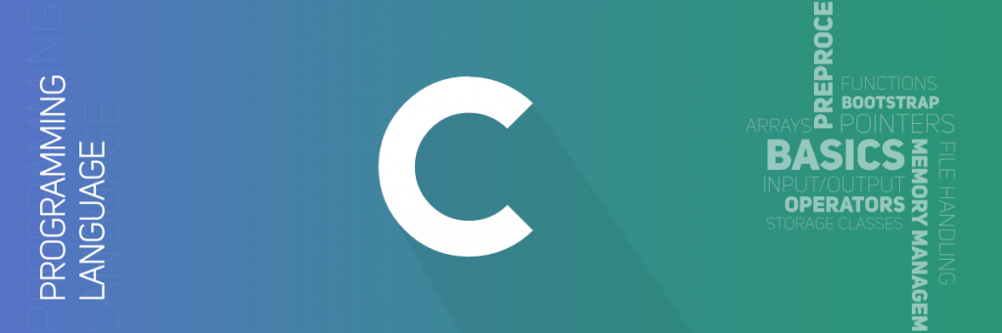
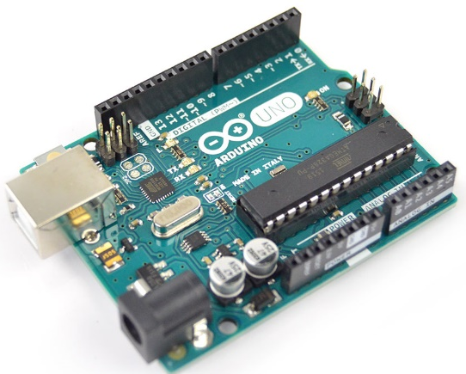

Basic Elements in C/C++

Slide 2
Introduction
A computer program is a set of instructions used to operate a computer to produce a specific result
Writing computer programs is called computer programming
The languages used to create computer programs are called programming languages

Slide 3
Programing Language Generation
Machine languages are the lowest level of computer languages. Programs written in machine language consist of 1s and 0s
Assembly languages perform the same tasks as machine languages, but use symbolic names for opcodes and operands instead of 1s and 0s
ADD A,B
High level programming languages create computer programs using instructions that much easier to understand

Slide 4
Compiler
Programs in a high-level languages must be translated into a low level language using a program called a compiler
Compiler: Translate all the instructions and then, execute them
Interpreter: Translate and Execute one by one instruction

Slide 5
Programming IDE
IDE = Integrated Development Environment
Programming Editor: An environment for editing a program
Online IDE: http://cpp.sh/

Slide 6
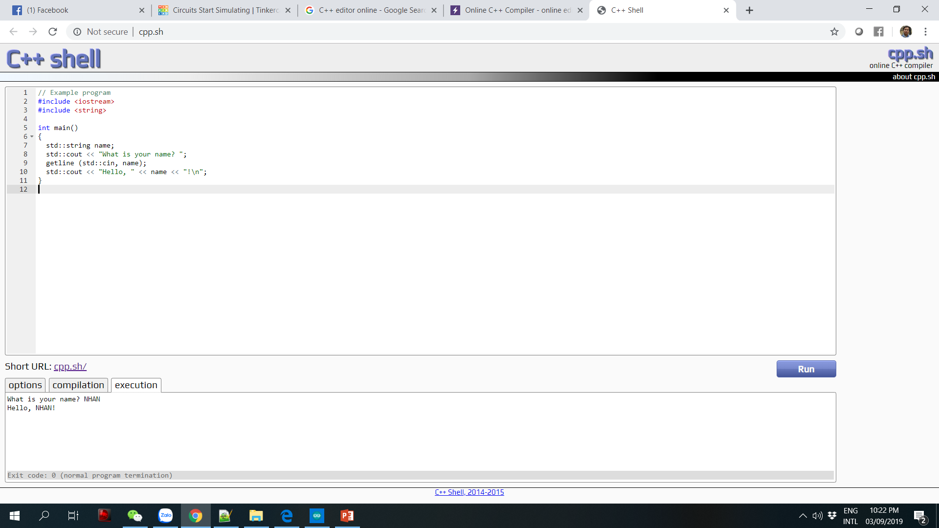
C++ Shell

Slide 7
The main() function
The main() function is a special function that runs automatically when a program first executes
All C++ programs must include one main() function. All other functions in a C++ program are executed from the main().
The keyword before the main, e.g. int main() is called a function header line, or the return of the main in integer number.

Slide 8
Output: cout object
The cout object is an output object that sends data given to it to the standard output display device
To send a message to the cout object, you use the following pattern:
cout << “Hello World”;
printf is also an instruction to print something to the screen:
printf(“Hello World”);
In C, only printf is supported

Slide 9
Data Type and Variable
int a;
int a = 10;
2 or 4 bytes
float b;
float b = 2.5
4 bytes

Slide 10
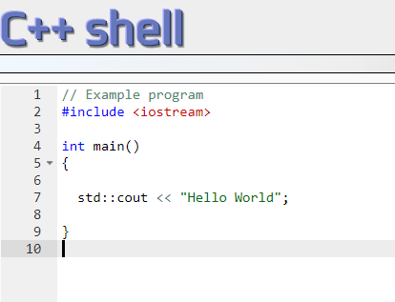
A Simple Program
Header file
Namespace
#include is not an instruction, it is a directive

Slide 11
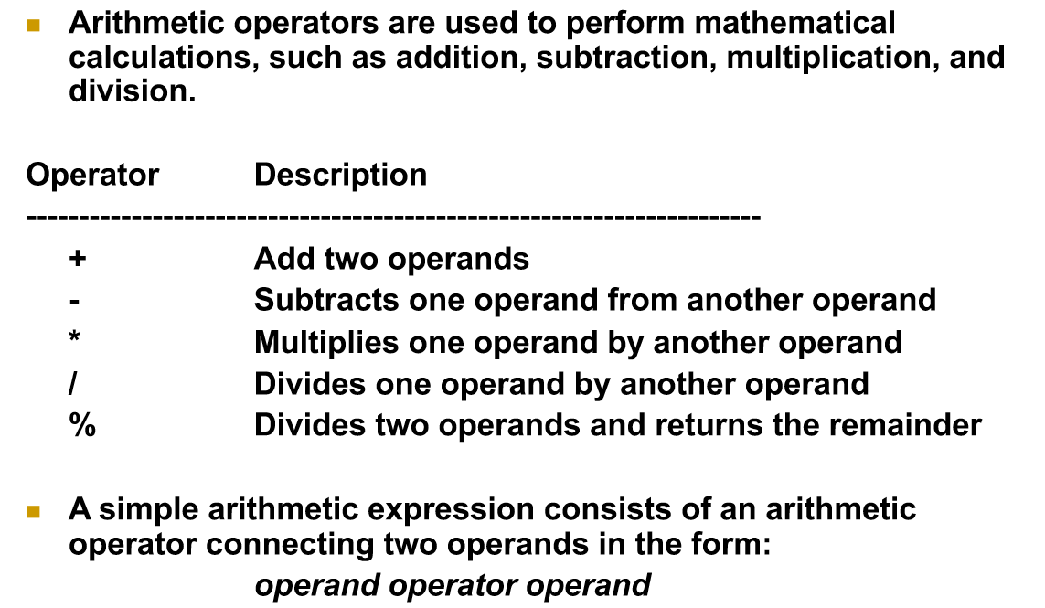
Operators

Slide 12
Branch and Loop Statements in C

Slide 13
Branch Statement
Branch statement allows us to select an action based on some conditions
For example: if user inputs valid account number and pin, then allow money withdrawal, otherwise, alert a message
If statement works like "If condition is met, then execute the task".

Slide 14
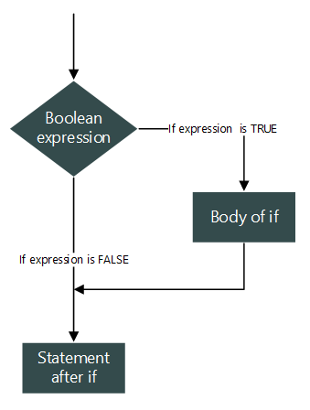
Simple IF
if(boolean_expression) {
// body of if
}
Boolean_expression returns true or false
Value zero is false, others are true

Slide 15
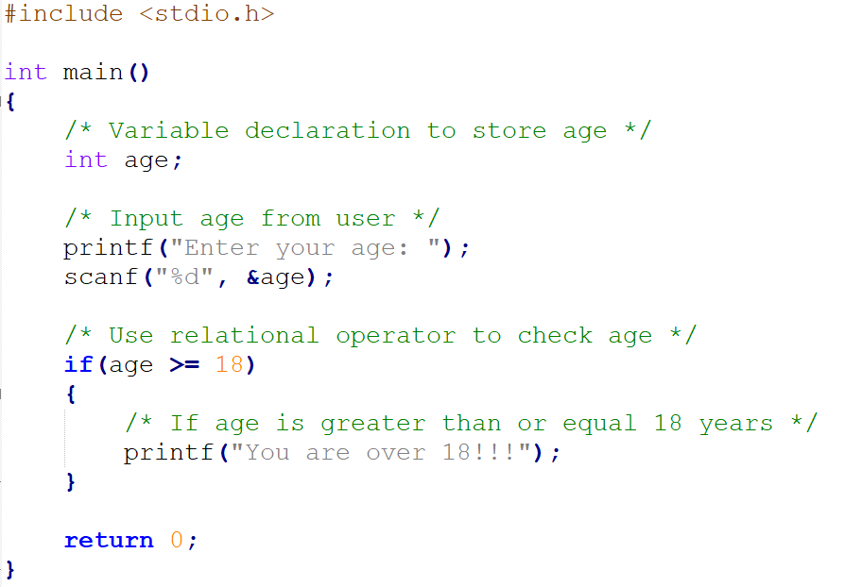
Example

Slide 16
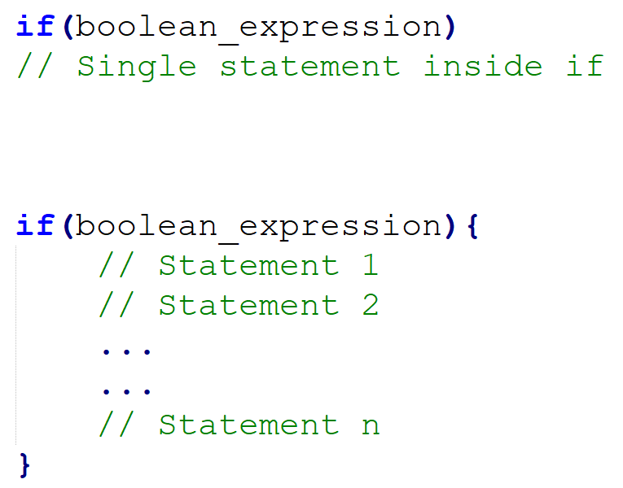
Single and Multiple Statements
Single statement : { and } are optional
Multiple statements : { and } are mandatory

Slide 17
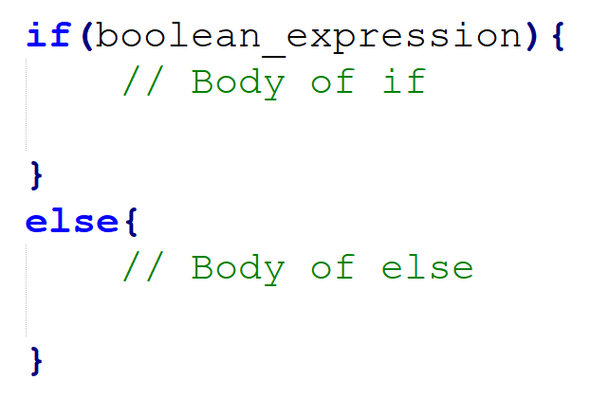
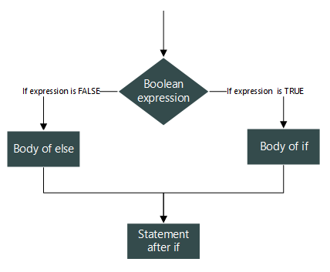
If Else Statement

Slide 18
Exercise
For a given 3 Integer numbers, write a short program to find the maximum number
For a given 4 Integer numbers, write a short program to find the minimum number

Slide 19
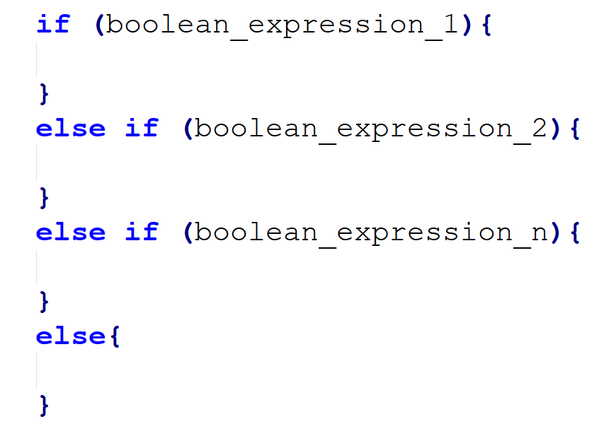
Multiple conditions

Slide 20
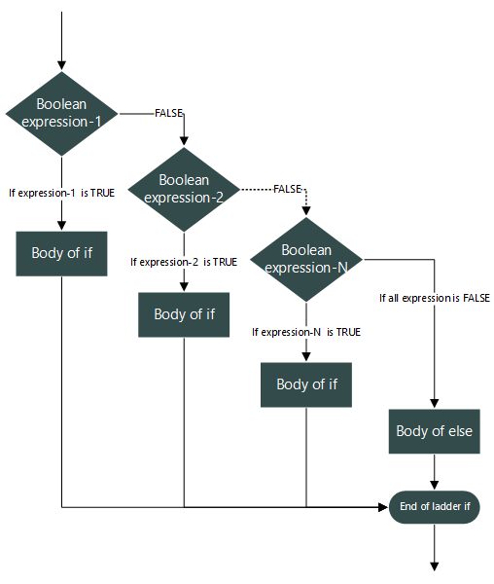
Execution Flow
Conditions are checked one by one
When one condition is true, the if is stopped

Slide 21
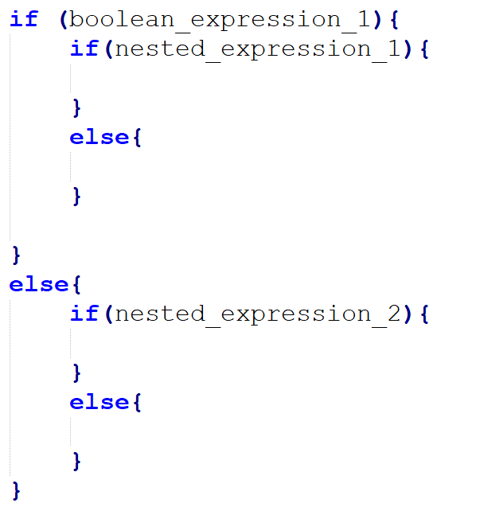
Nested IF

Slide 22
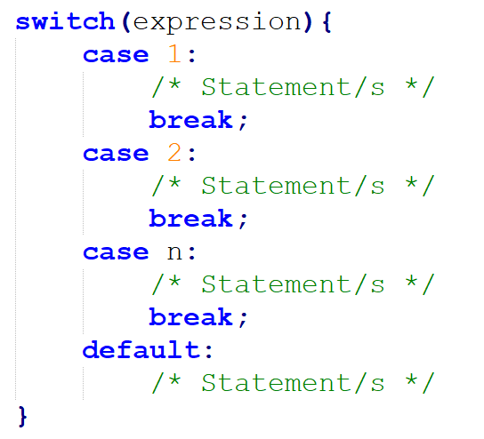
Switch case

Slide 23
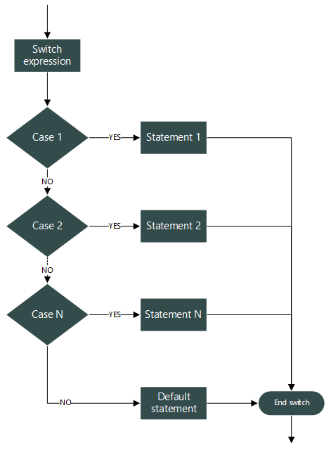
Flow chart of switch case
Expression inside switch must evaluate to integer, character or enumeration constant
switch...case only works with integral, character or enumeration constant
The execution is jumped directly to the right condition instead of checking one by one as if else

Slide 24
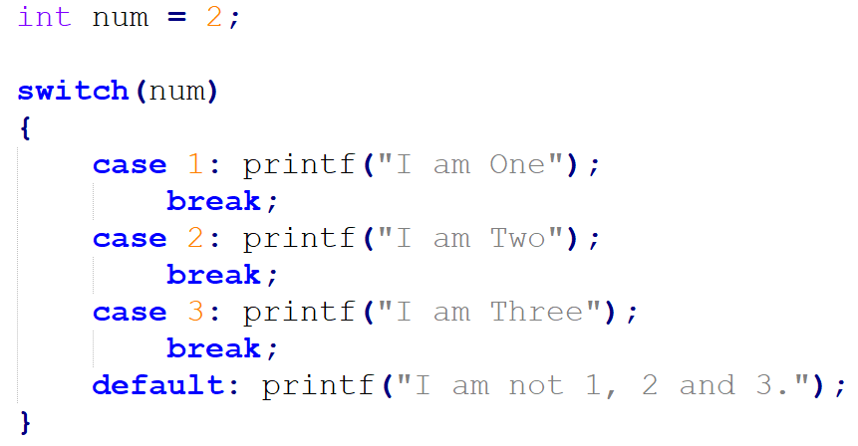
Example

Slide 25
IF ELSE and SWITCH CASE
Use if...else...if statement when:
There are conditions instead of list of choices.
There are few number of conditions.
Use switch...case when:
There is a list of choices, from which you need to take decision.
Choices are in the form of integer, character or enumeration constant
Further reading: enumerable declaration, state machine, deterministic finite automata

Slide 26
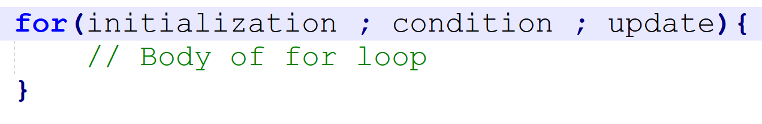
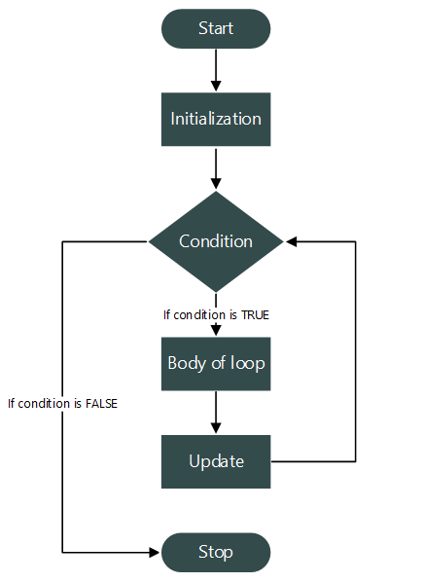
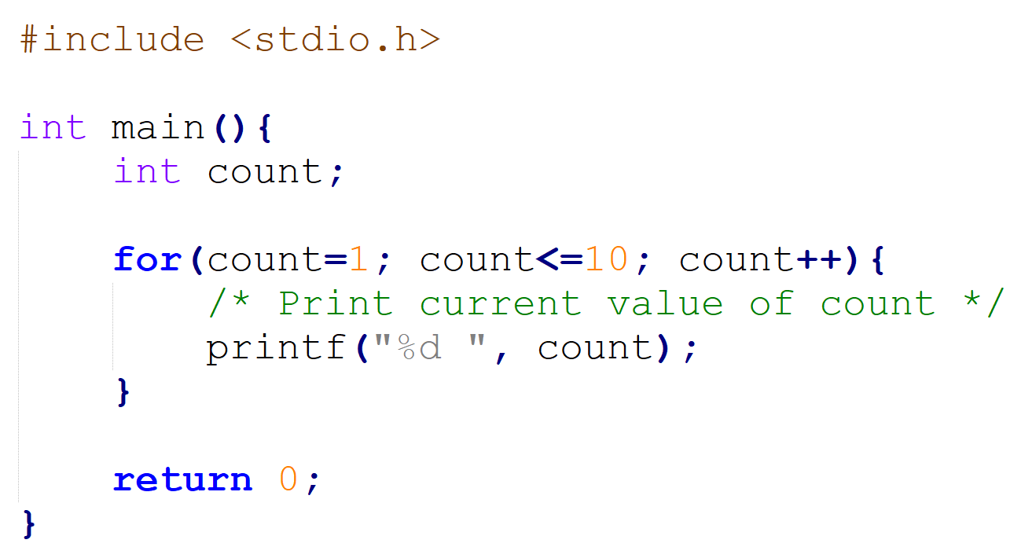
Looping Statement: FOR

Slide 27
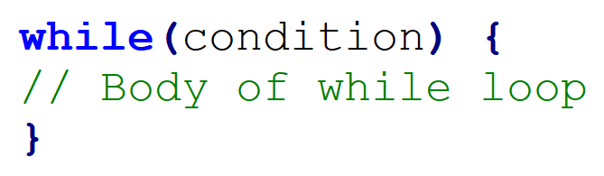
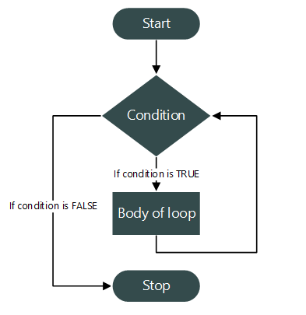
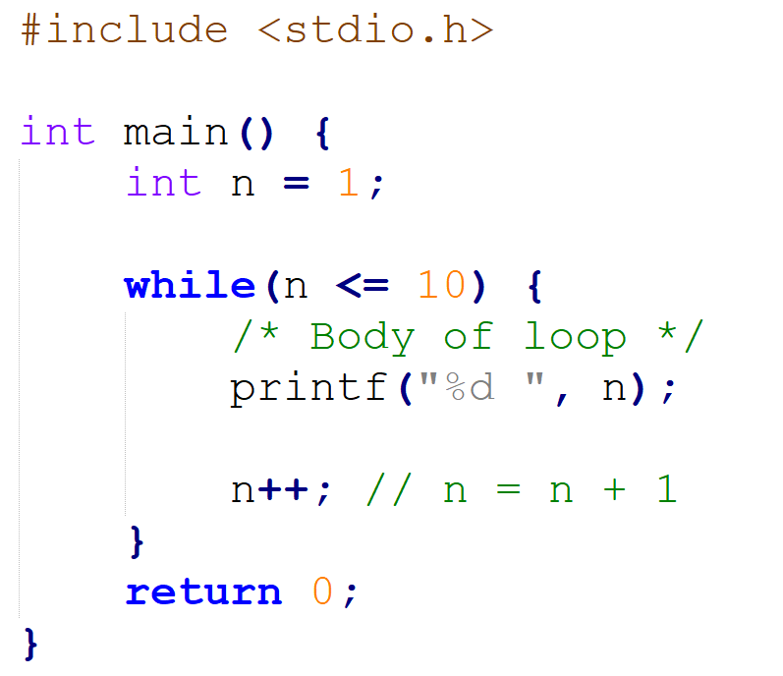
Looping Statement: WHILE

Slide 28
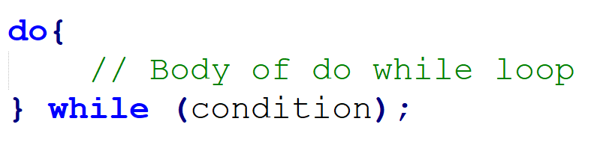
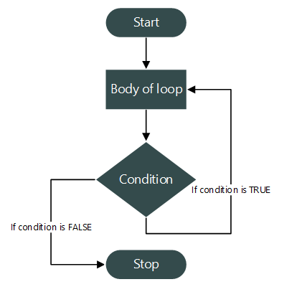
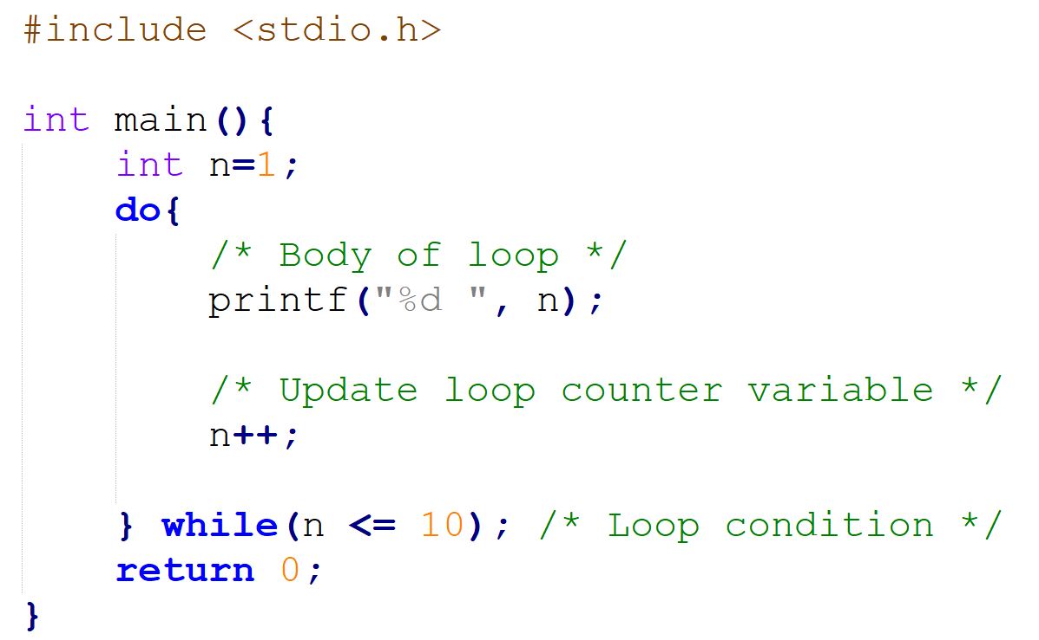
Looping Statement: DO WHILE

Slide 29
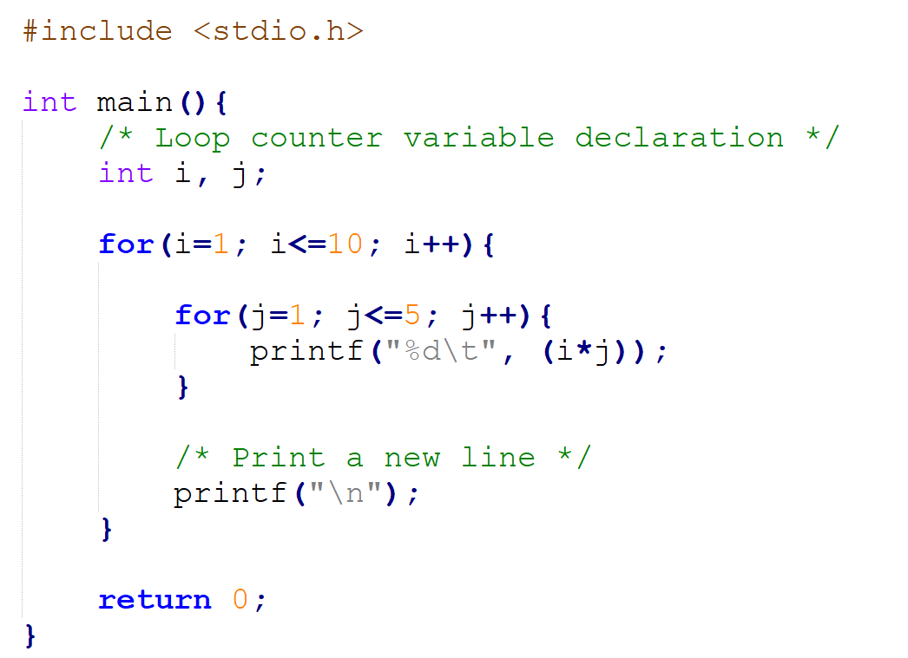
Nested Loop

Slide 30
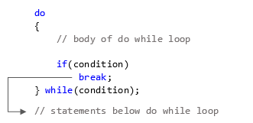
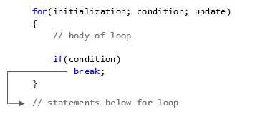
Break statement in Loop

Slide 31
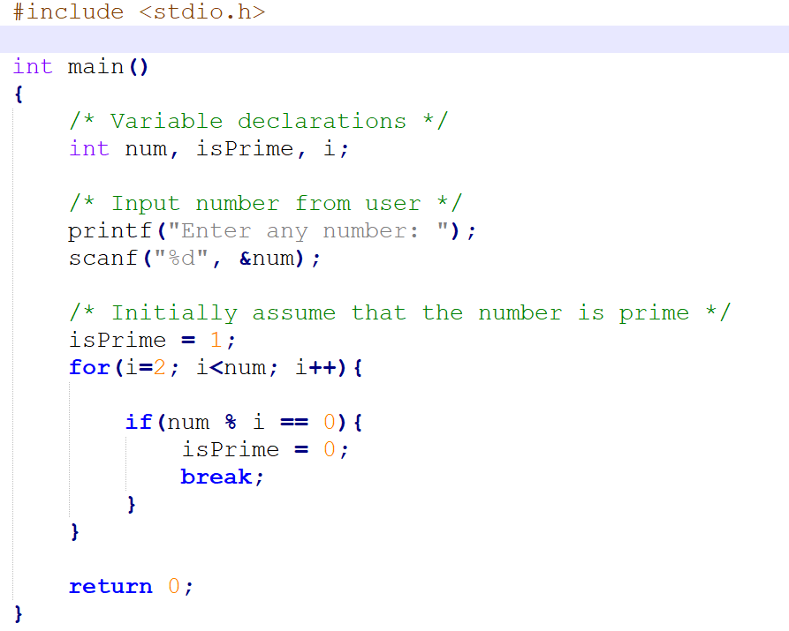
Example: Check a Prime Number

Slide 32
Question
Why we need a break statement instead of putting it in the condition statement of the loop

Slide 33
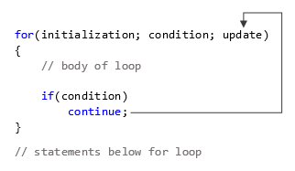
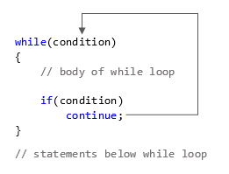
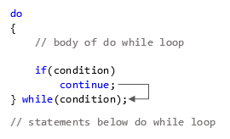
Continue in Loop

Slide 34
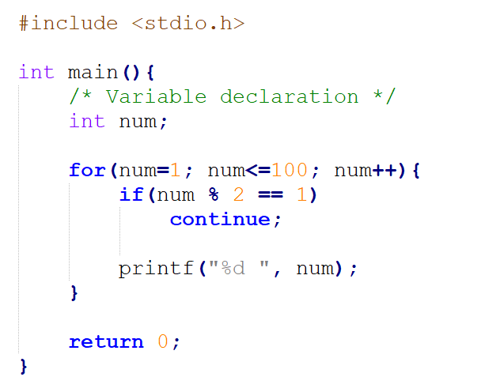
Example
What are printed to the console?

